Slide 1
Create Digital Passes Using
Wallet kit
Speaker: E Sujith
Sr Android Developer

Slide 2

Sujith E
Sr Android Developer
I have been working as a Sr Developer in Huawei. previously worked on various domains like Mining ,e-commerce ,etc. . Over all having 4+ years of experience.

Slide 3
Introduction about wallet kit
How can I integrate wallet Kit?
Server side Integration - Demo
Client side Integration - Demo

Slide 4
/ 01
INTRODUCTION
Wallet Kit to provide easy-to access digital passes on an integrated platform. This Allows users to save their Loyalty Card, Movie Tickets, Gift coupons and Boarding Pass etc.…! in their Smartphones.
It enables location-based notifications and real-time status updates.

Slide 5
/ 02
How can I integrate wallet Kit?
1. Generating Public and Private Keys
2. Config App in AGC
3. Adding Pass type on the AGC

Slide 6
2- 1 Generate private & public Keys
1. You have to download first RSAUtils.zip folder
https://developer.huawei.com/consumer/en/doc/development/HMS-Guides/wallet-preparations-scret
2. Open RSA folder and double click start.bat file automatically private and public key has been generated in out folder

Slide 7
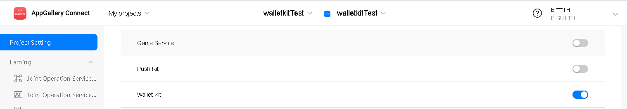
2.2- How can I Config app in AGC?
Create Sample Demo application in android Studio
Open AppGallery Connect create new Project
Enable Wallet kit API Service
Register wallet kit in AGC

Slide 8
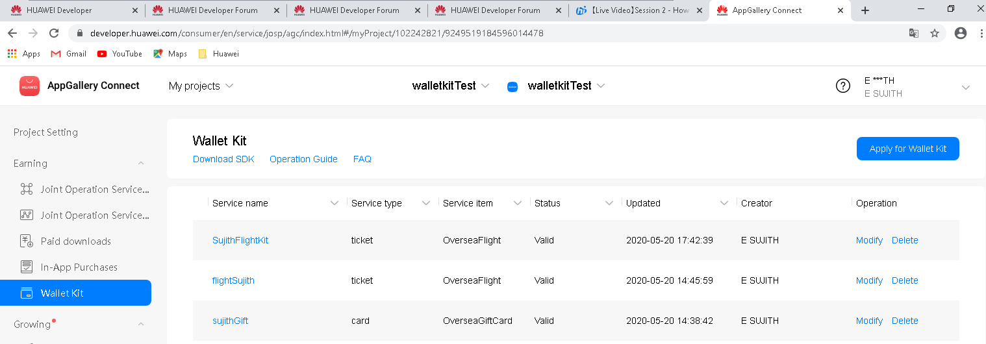
2.3 – How to add Pass type template in AGC
Select your project in AppGalley Connect
Go to Develop tab select Earning click wallet
Apply Wallet kit

Slide 9
/ 03
Server Side Integration
1. What are all software requires
2. Code Sample

Slide 10



3.1- Software Requirements
Intelliji IDEA
Java JDK
Maven dependency

Slide 11
3.2- Code Implementation
How to generate Templates and Objects ?
First we need to Generate Model then Instance.
Only the server has the interface for generating a model
How to do wallet kit integration server side ?
Download server Demo
Configure Sample Code into Intelliji IDEA.
Download and import required dependency
Build your project

Slide 12
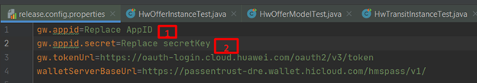
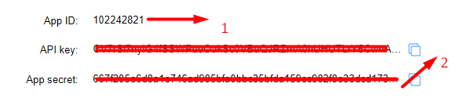
Step 1 – Modify Config file
1. Open release.config.properties in your Project in this class we need to replace our APP Id & Secret Key
2. Select your project in AppGalley Connect Copy App Id and Secret key.

Slide 13
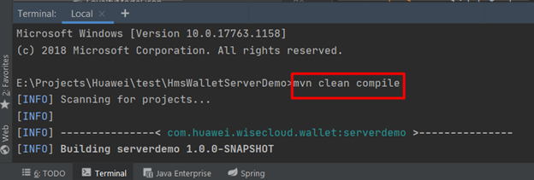
Step -2 :- Compile Project
Open Terminal in Intelliji IDEA
Compile your project mvn clean compile
3. After Project compilation Automatically Target folder will generate. Copy hmspass folder in the config directory, paste into the target/classes directory

Slide 14
Step -3 :- Generate Pass Model
After Project compilation Automatically Target folder will generate. Copy hmspass folder in the config directory, paste into the target/classes directory .
The file ends with ModelTest provides the examples of adding, modifying and pass model. we need to modify
accordingly .
Open any model.Json file replace your PassTypeIdentifier and passStyleIdentifier both unique After completion of modify open the HwFlightModelTest file and Run CreateFlightModel() method.
when you execute this method createFlightModel JSON will generate .

Slide 15
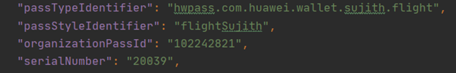
Step -4 :- Generate Pass Instance
Open FlightIntance.json file replace all below values. While generating Instance SerialNumber number need to be change every time.
2. After Completion of modification execute CreateFlightInstance() to generate pass instance.

Slide 16
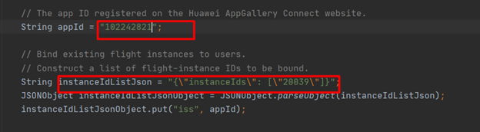
Step -5 :- Generating JWE Character String
Open InstanceTest file execute generateThinJWEToBindUser(). Before executing this we have to change key values
2. After executing this function JWE String will generate.

Slide 17
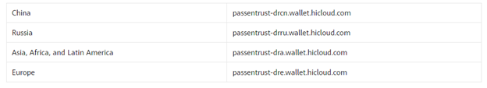
Step -6 :- Binding Pass by URL
Huawei provides an interface binding pass through the URL.
wallet kit website URL we need to select based on region
https://{walletkit_website_url}/walletkit/consumer/pass/save?jwt={jwt-content}

Slide 18
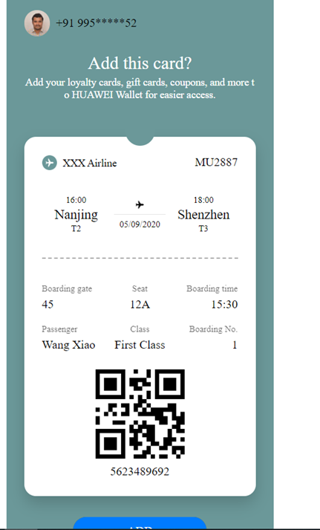
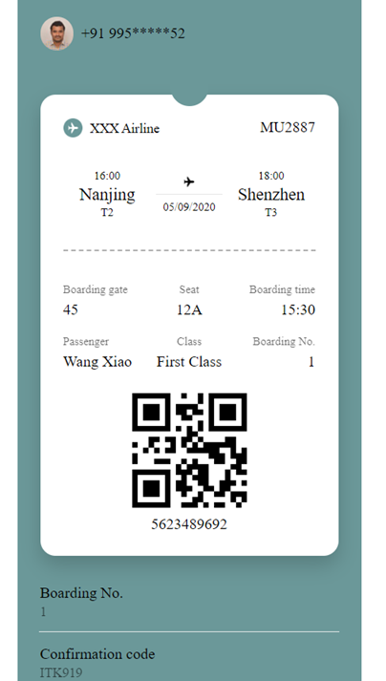
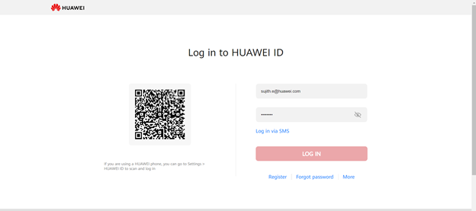
Step -7 :- Result
After binding Url open into browser using this URL ,it will redirect into login page after successfully login need to add pass into wallet.
We can check cards Huawei wallet App. search AppGallery in mobile download Huawei wallet app

Slide 19
/ 04
Client Side Integration
1. What are all software requires
2. Code Sample

Slide 20



4.1 :- What are all the software's requires?
Android Studio 3.X
Java JDK (1.8 or later)
Gradle (4.6 or later)
SDK Platform (19 or later)

Slide 21
4.2 :- Client side integration procedure?
1. Create app &add dependencies
2. Change Private Key
3. Enter your pass information
4. Bind URL Passes
5. Card view status & check passes in wallet app

Slide 22
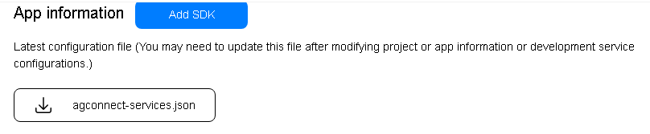

4.2.1 :- App Creation & add Required Dependencies
Create application configure app into AppGallery
Download agconnect-services.json add into your app directory folder
3. Add required dependencies
4 Sync your project

Slide 23
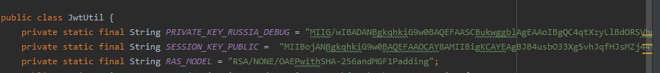
4.2.2:- Change Private Key
Open JwtUtil class in your project replace private key, file that is generated when the public key and private key are generated from RSAUtils.zip

Slide 24
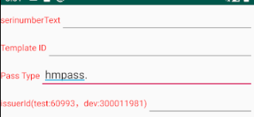
4.2.3:- Enter your pass information.
Run your application in Huawei device.
Enter below required values template Id and pass type are unique ,while creating wallet AGC which you define both needs match, serial number should be unique, issuer Id is your app Id

Slide 25
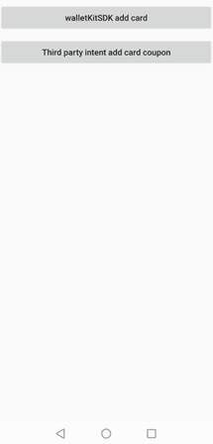
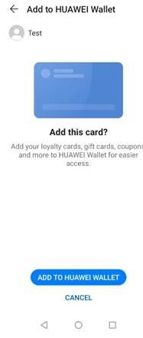
4.2.4:-Bind URL
After updating fields submit your card information, it will redirect to login page.
After successful login it will ask to Huawei wallet card

Slide 26
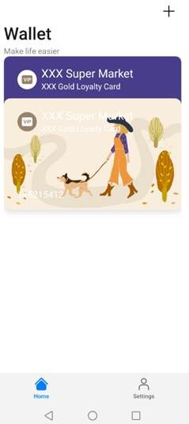
4.2.5 :- Open wallet App Check Passes
We can check cards Huawei wallet App. search AppGallery in mobile download Huawei wallet app

